Slide 1

Entrepreneurship: Successfully Launching New Ventures
Sixth Edition
Chapter 14
Strategies for Firm Growth
Notes:
If this PowerPoint presentation contains mathematical equations, you may need to check that your computer has the following installed:
1) MathType Plugin
2) Math Player (free versions available)
3) NVDA Reader (free versions available)

Slide 2
Learning Objectives
14.1 Identify and discuss the core internal growth strategy for entrepreneurial firms.
14.2 Describe additional internal product-growth strategies entrepreneurial firms can use.
14.3 Examine international expansion as a growth strategy.
14.4 Discuss different types of external growth strategies.

Slide 3
Internal and External Growth Strategies (1 of 2)
Internal Growth Strategies
Involve efforts taken within the firm itself, such as new product development, other product-related strategies, and international expansion
External Growth Strategies
Rely on establishing relationships with third parties, such as mergers, acquisitions, strategic alliances, joint ventures, licensing, and franchising

Slide 4
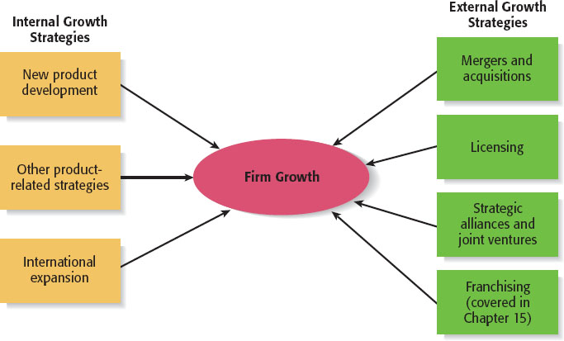
Internal and External Growth Strategies (2 of 2)
Figure 14.1

Slide 5
Internal Growth Strategies (1 of 2)
New product development
Additional internal product-growth strategies
International expansion

Slide 6
Internal Growth Strategies (2 of 2)
Table 14.1 Advantages and Disadvantages of Internal Growth Strategies
Advantages
Incremental, even-paced growth.
Provides maximum control.
Preserves organizational culture.
Encourages internal entrepreneurship.
Allows firms to promote from within.
Disadvantages
Slow form of growth.
Need to develop new resources.
Investment in a failed internal growth strategy can be difficult to recoup.
Adds to industry capacity.

Slide 7
New Product Development (1 of 3)
Involves the creation and sale of new products (or services) as a means of increasing firm revenues.
In many fast-paced industries, new product development is a competitive necessity.
For example, the average product life cycle in the computer software industry is 14 to 16 months.
As a result, to remain competitive, software companies must always have new products in their pipeline.

Slide 8
New Product Development (2 of 3)
Keys to Effective New Product and Service Development
Find a need and fill it.
Develop products that add value.
Get quality and pricing right.
Focus on a specific target market.
Conduct ongoing feasibility analysis.

Slide 9
New Product Development (3 of 3)
Table 14.2 The Top 5 Reasons New Products Fail
The potential market was overestimated.
Customers saw the product as too expensive.
The product was poorly designed.
The product was no different than the competition’s (“me too” products).
The costs of developing the product line were too high.

Slide 10
Additional Internal Product-Related Strategies
Product Strategy | Description
Improving an Existing Product or Service | Often a business can increase its revenues by simply increasing the quality of an existing product or service.
Increasing Market Penetration | Increasing the sales of a product or service through greater marketing efforts or through increased production capacity.
Extending Product Lines | Making additional variations of a product so it will appeal to a broader range of clientele.
Geographic Expansion | Growth via expanding to additional geographic locations.

Slide 11
International Expansion (1 of 3)
Another common form of growth for entrepreneurial firms.
International new ventures are businesses that, from their inception, seek to derive significant competitive advantage by using their resources to sell products or services in multiple countries.
Although there is vast potential associated with selling overseas, it is a fairly complex form of growth.

Slide 12
International Expansion (2 of 3)
Foreign-Market Entry Strategies
Exporting
Producing a product at home and shipping it to a foreign market.
Joint Ventures
Involves the establishment of a firm that is jointly owned by two or more otherwise independent firms.
Fuji-Xerox is a joint venture between an American and a Japanese company.
Licensing
An arrangement whereby a firm with the proprietary rights to a product grants permission to another firm to manufacture that product for specified royalties or other payments.

Slide 13
International Expansion (3 of 3)
Franchising
An agreement between a franchisor (a company like McDonald’s Inc., that has an established business method and brand) and a franchisee (the owner of one or more McDonald’s restaurants).
Turnkey Project
A contractor from one country builds a facility in another country, trains the personnel that will operate the facility, and turns over the keys to the project when it is completed and ready to operate.
Wholly Owned Subsidiary
A company that has made the decision to manufacture a product in a foreign country and establish a permanent presence.

Slide 14
External Growth Strategies (1 of 2)
Mergers and Acquisitions
Licensing
Strategic Alliances and Joint Ventures
Franchising (Chapter 15)

Slide 15
External Growth Strategies (2 of 2)
Table 14.5 Advantages and Disadvantages of Emphasizing External Growth Strategies
Advantages
Reducing competition.
Gaining access to proprietary products or services.
Gaining access to new products and markets.
Obtaining access to technical expertise.
Gaining access to an established brand name.
Economies of scale.
Diversification of business risk.
Disadvantages
Incompatibility of top management.
Clash of corporate cultures.
Operational problems.
Increased business complexity.
Loss of organizational flexibility.
Antitrust implications.

Slide 16
Mergers and Acquisitions
Mergers and Acquisitions
A merger is the pooling of interests to combine two or more firms into one.
An acquisition is the outright purchase of one firm by another.
Purpose of Acquisitions
Acquiring another business can fulfill several of a company’s needs, such as:
Expanding its product line.
Gaining access to distribution channels.
Achieving competitive economies of scale.

Slide 17
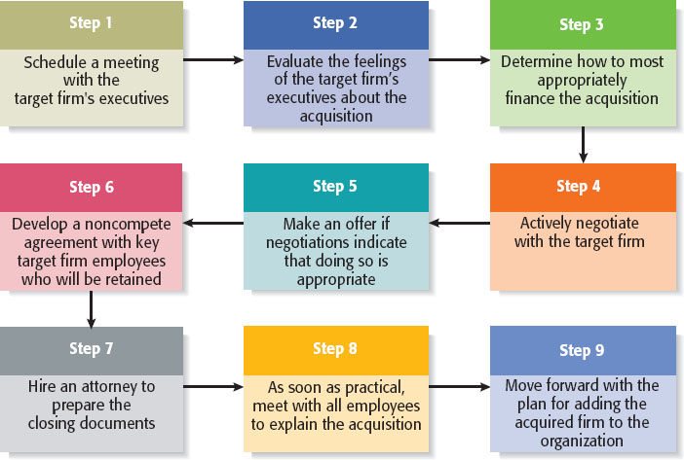
The Process of Completing an Acquisition
Figure 14.2 The Process of Completing the Acquisition of Another Firm

Slide 18
Licensing (1 of 2)
The granting of permission by one company to another company to use a specific form of its intellectual property under clearly defined conditions.
Virtually any intellectual property a company owns that is protected by a patent, trademark, or copyright can be licensed to a third party.
Licensing Agreement
The terms of a license are spelled out by a licensing agreement.

Slide 19
Licensing (2 of 2)
Type of Licensing | Description
Technology Licensing | The licensing of proprietary technology that the licensor typically controls by virtue of a utility patent.
Merchandise and Character Licensing | The licensing of a recognized trademark or brand that the licensor typically controls through a trademark or copyright.

Slide 20
Strategic Alliances and Joint Ventures (1 of 2)
The increase in the popularity of strategic alliances and joint ventures has been driven largely by a growing awareness that firms can’t “go it alone” and succeed.

Slide 21
Strategic Alliances and Joint Ventures (2 of 2)
Table 14.6 Advantages and Disadvantages of Participating in Strategic Alliances and Joint Ventures
Advantages | Disadvantages
Gain access to a specific resource. Economies of scale. Risk and cost sharing. Gain access to a foreign market. Learning. Speed to market. Neutralizing or blocking competitors. | Loss of proprietary information. Management complexities. Financial and organizational risks. Risk becoming dependent on a partner. Partial loss of decision autonomy. Partners’ cultures may clash. Loss of organizational flexibility.

Slide 22
Strategic Alliances (1 of 2)
A strategic alliance is a partnership between two or more firms developed to achieve a specific goal.
Various studies show that participation in alliances can boost a firm’s rate of patenting, product innovation and foreign sales.
Strategic alliances tend to be informal and do not involve the creation of a new entity.
Setting up an alliance and making it work can be tricky.

Slide 23
Strategic Alliances (2 of 2)
Type of Alliance | Description
Technological Alliances | Feature cooperation in R&D, engineering, and manufacturing.
Marketing Alliances | Typically match a company with excess distribution capacity with a company that has a product to sell.

Slide 24
Joint Ventures (1 of 2)
A joint venture is an entity created when two or more firms pool a portion of their resources to create a separate, jointly owned organization.
A common reason to form a joint venture is to gain access to a foreign market. In these cases, the joint venture typically consists of the firm trying to reach a foreign market and one or more local partners.

Slide 25
Joint Ventures (2 of 2)
Type of Joint Venture | Description
Scale Joint Venture | Partners collaborate at a single point in the value chain to gain economies of scale in production or distribution.
Link Joint Venture | Positions of the partners are not symmetrical, and the partners help each other access adjacent links in the value chain.

Slide 26

Copyright

